Slide 1
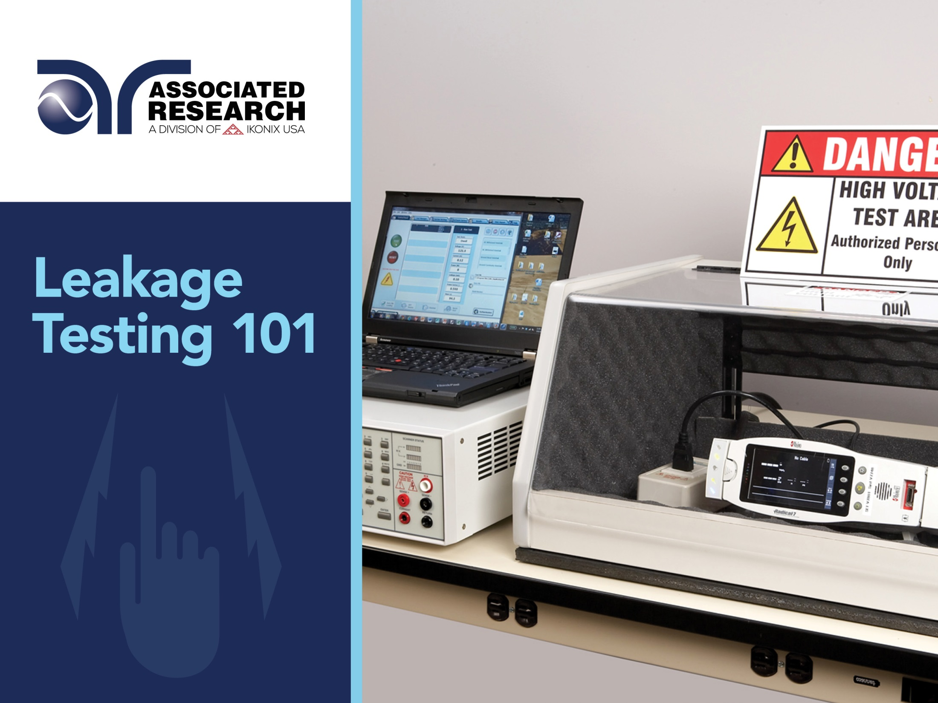

Slide 2


Slide 3
Webinar Notes
  Please use the Q & A utility to ask us any questions concerning
  the material being presented.
  Please contact Brittany Socha- chat line or email brittany.socha@arisafety.com if you would like a copy of the presentation.

Slide 4
Leakage Current Testing 101 – Introduction
Shock Hazards
Potential shock hazards
Leakage Current
What is leakage current?
Touch Current
Examples
What is Touch Current?
Video demonstrations
Effects of current on the human body
Human body impedance
Types of insulation barriers
Touch current types
How it is measured
By the standards

Slide 5


Potential Shock Hazards
Contact made from circuit point to ground
Contact made between two points of a circuit

Slide 6
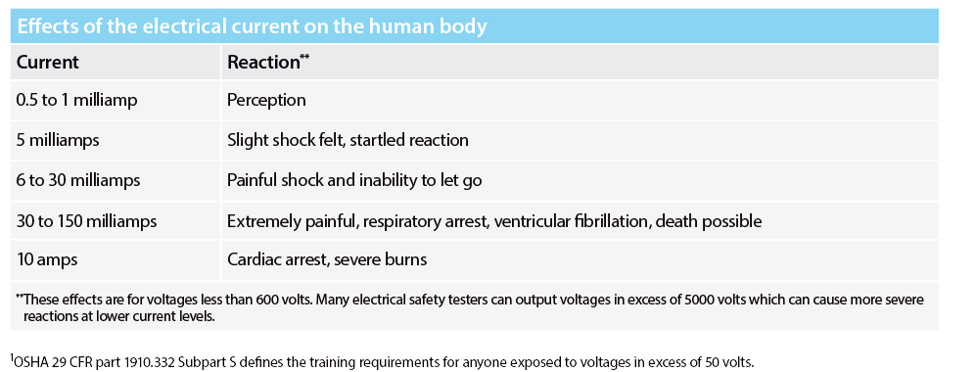
Effects of Electrical Current on the Human Body
These limits can vary between people and different environments.
For example, women have a slightly different threshold then men for perception and pain as the result of exposure to electric current.

Slide 7

Human Body Resistance
The human body on an average has about 1000 to 1500 ohms resistance.
The outer layer of the skin provides the largest percentage of the body’s electrical resistance.
The skin, has a breakdown voltage at which it ceases to act like a resistor and is simply “punctured” leaving only the lower resistance body tissue to impede the flow of current in the body.
The parts of the body which conduct the electricity the best are the blood vessels and nerves.

Slide 8

The current required to light
a 7 watt, 120V lamp, passed
across the chest is enough
to cause fatality.
I = 120V/1,000 Ohms = 0.120A

Slide 9
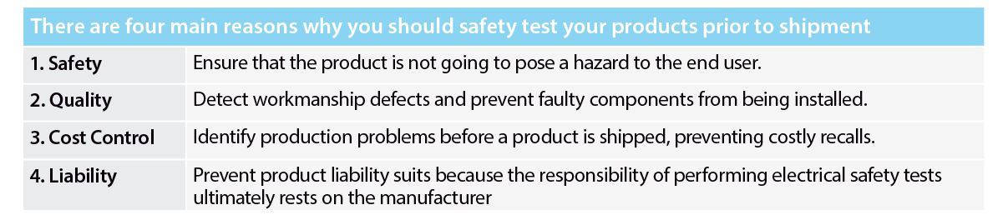
Why Test?
The bottom line is that if you want to get your product to market and it can pose an electrical hazard, it has to be tested per various standards for approval.

Slide 10
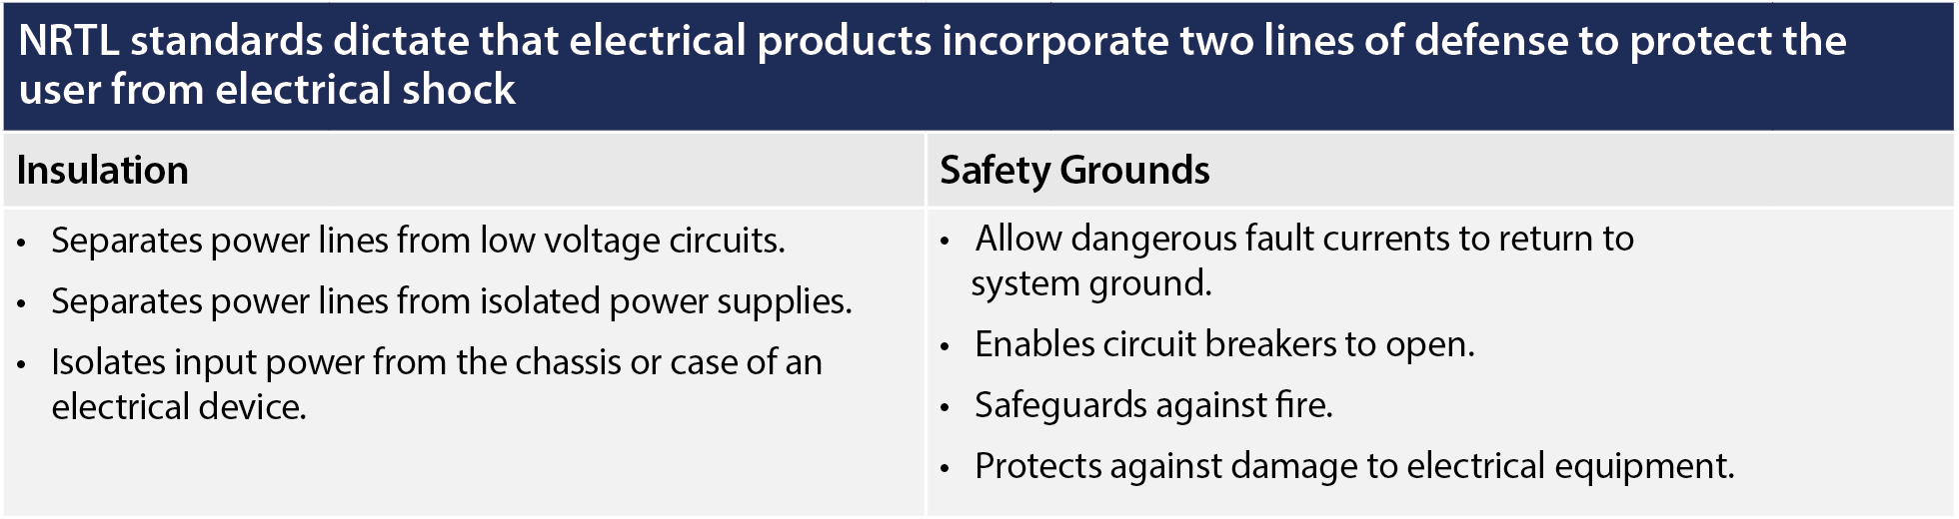
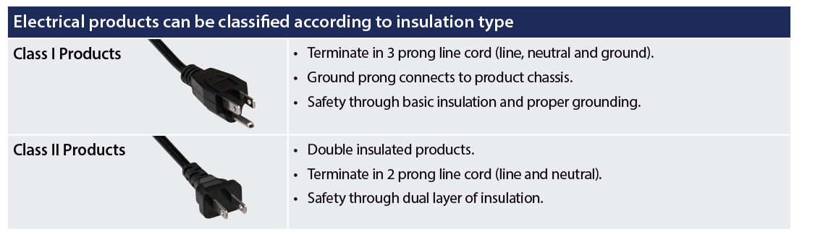

Slide 11
Poll Question 1

Slide 12
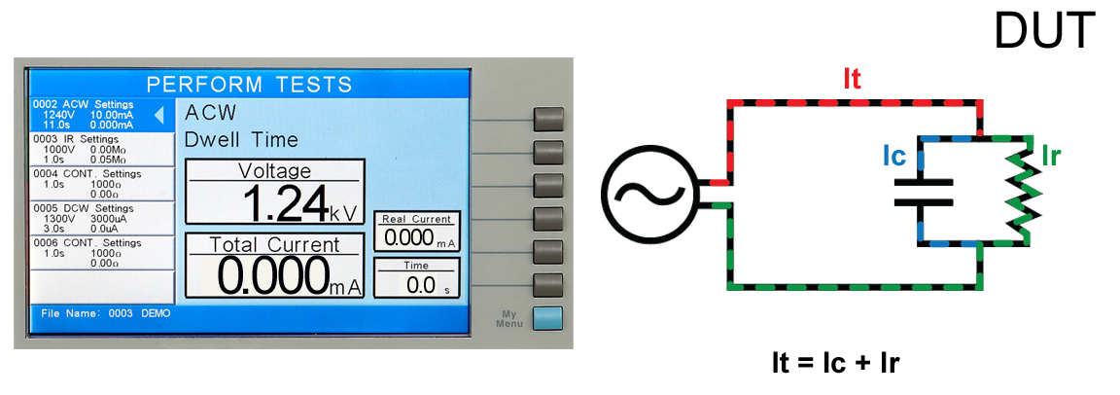
Leakage Current

Slide 13
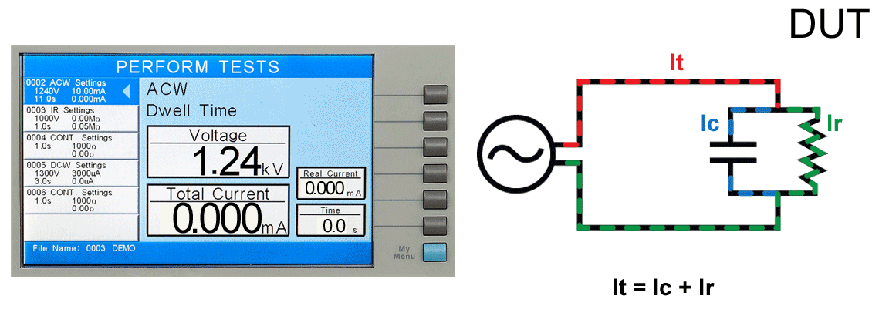
Leakage Current
Leakage current is the stray current that actually flows on the surface of and through the insulation. It is undesired current that we want to quantify to better understand the quality of an insulation barrier.

Slide 14
Leakage Current Types
Touch Current
Electric current through a human body when it touches one or more accessible parts of an installation or of equipment¹
Protective Conductor Current
Current which flows in a protective conductor¹
Also called Earth Leakage Current.
Also called Enclosure Leakage Current.
1 – IEC 60990 2nd edition: Methods of Measurement of Touch Current and Protective Conductor Current

Slide 15
How is this Different?
Touch
Current
Measured when the device is powered up during various operation states.
Hipot Leakage Current
Insulation stressed with high voltage and leakage current measured.
A hipot test measures leakage through product insulation while the device is powered off. Insulation is stressed by high voltage and the resulting leakage current is measured.

Slide 16
How is it Measured?
MD
Leakage current is measured through a human body impedance network, also known as a Measuring Device (MD)
Body Impedance
MD is designed to simulate the impedance of the human body under various conditions.
Normal and Single Fault Conditions
Measurements taken under normal conditions.
Measurements also taken under single fault conditions to simulate worst case scenarios
Leakage current is measured by an MD under normal and single fault conditions. The main question to ask: What is the severity of electric current someone would be exposed to if they were to touch the DUT under such conditions?

Slide 17
How is it Measured?
Medical Devices
IT Equipment
Electric Spas
MD will vary by product standard.
Most MDs are derived from IEC 60990-1.

Slide 18
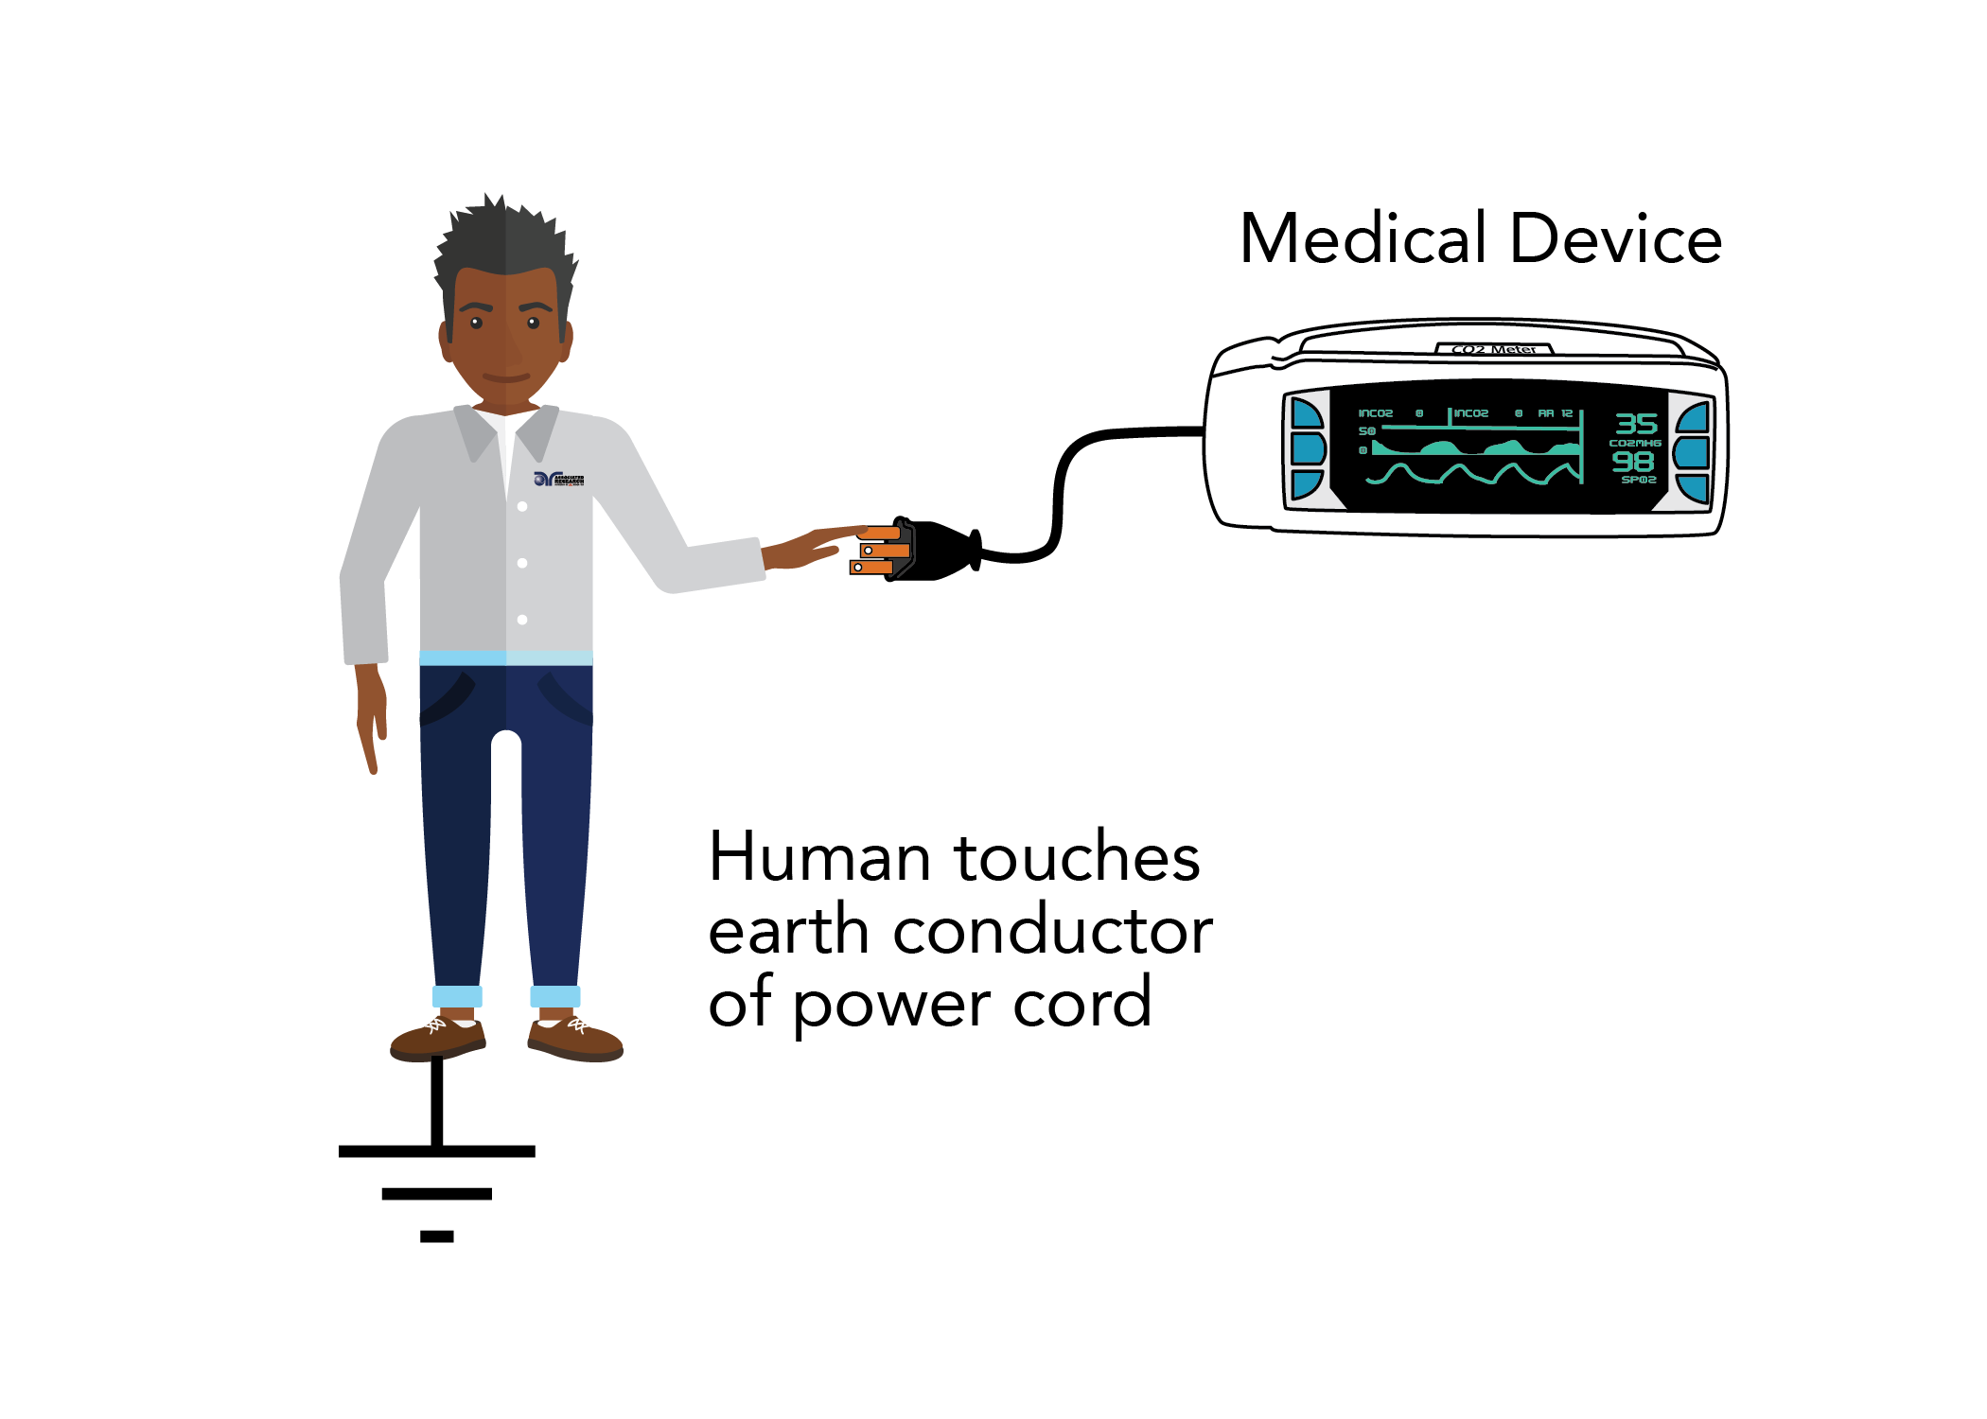
Earth Leakage
MD will vary by product standard.
Most MDs are derived from IEC 60990-1.

Slide 19
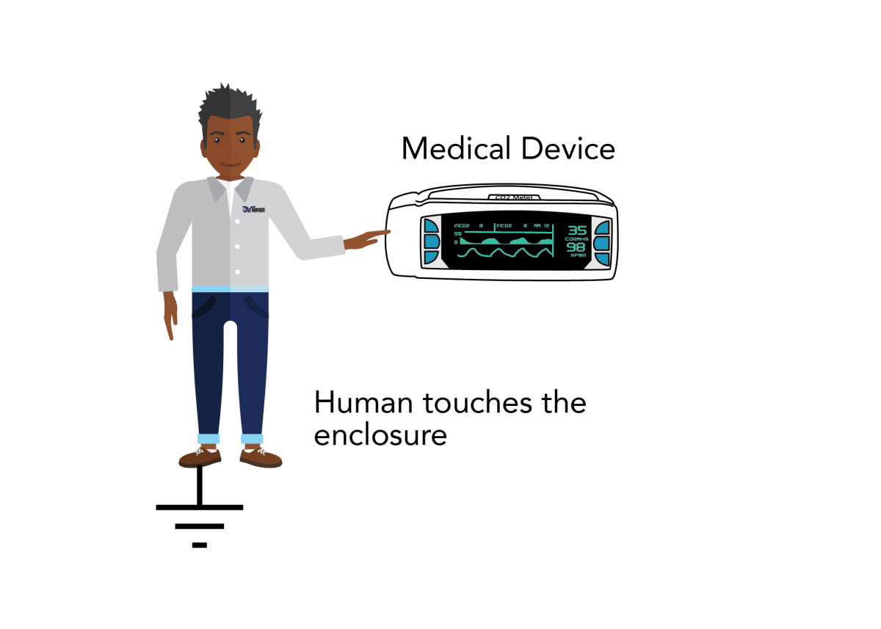
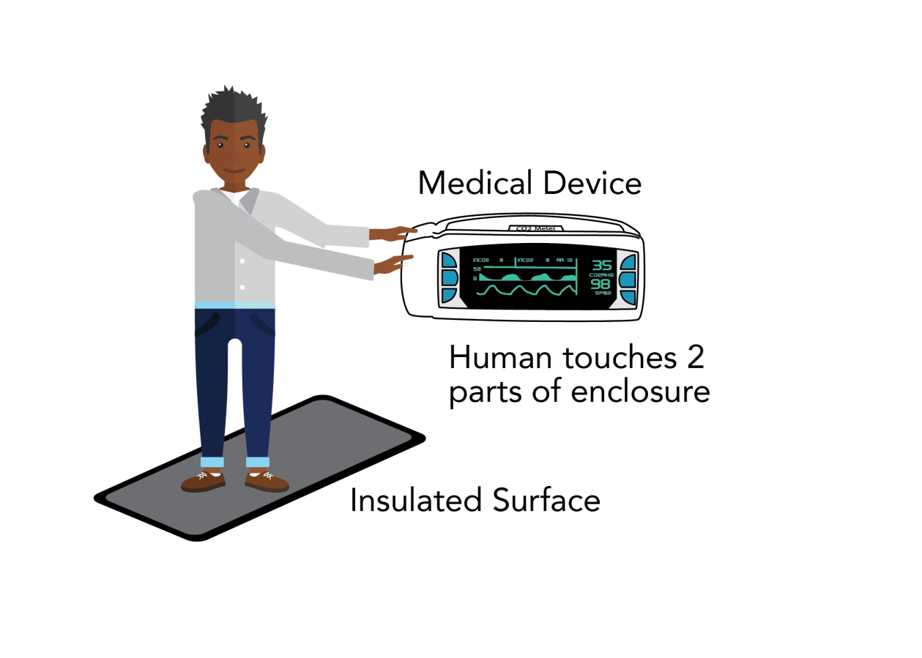
Enclosure Leakage
MD will vary by product standard.
Most MDs are derived from IEC 60990-1.

Slide 20
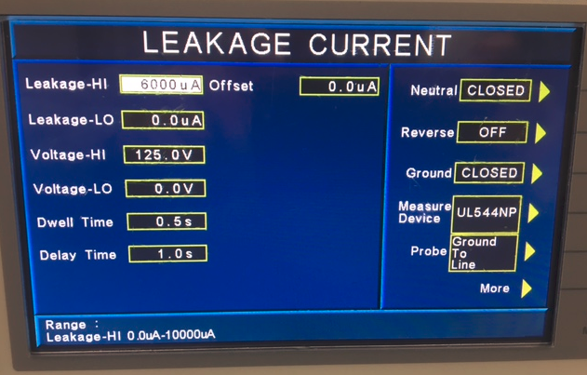
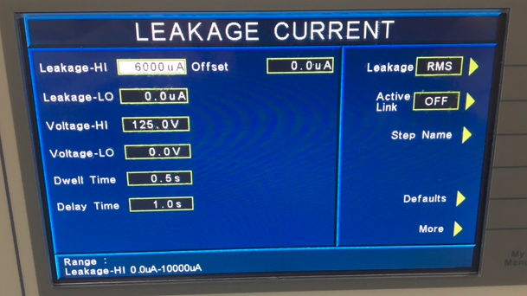

Slide 21
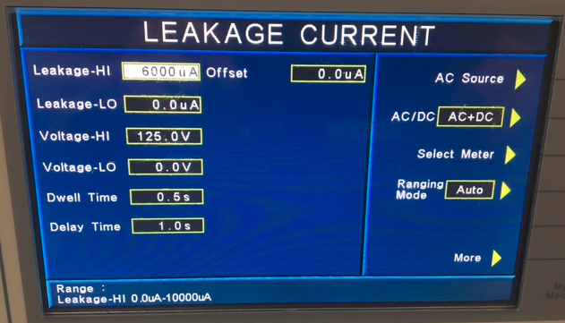
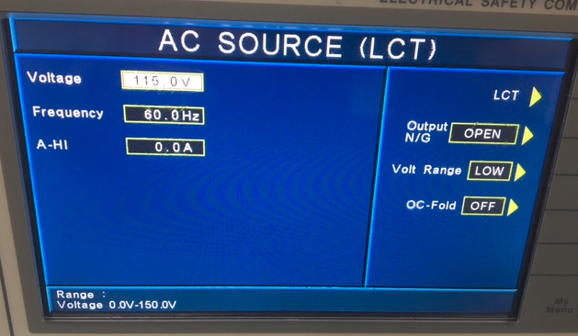

Slide 22
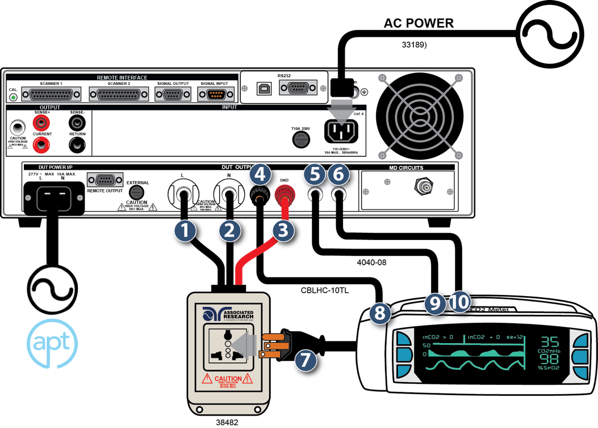

Slide 23
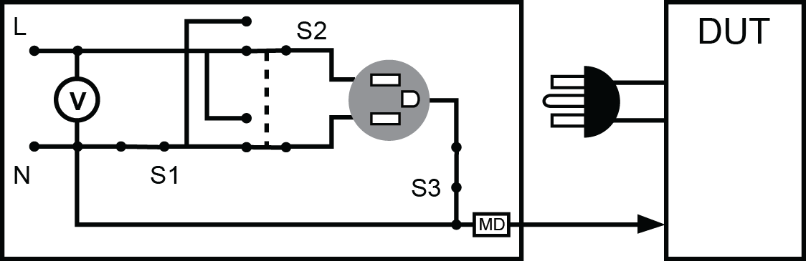

Slide 24
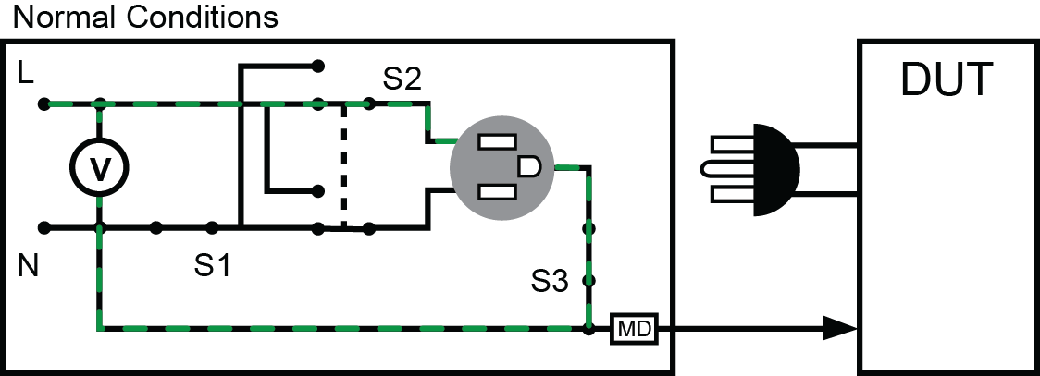

Slide 25
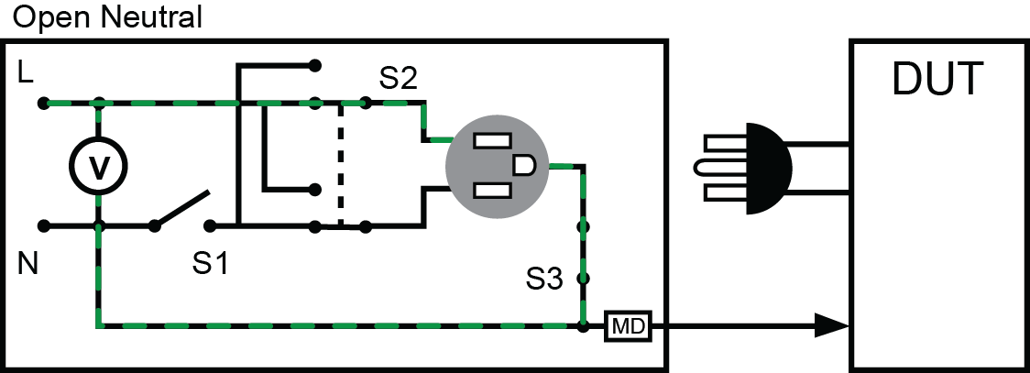

Slide 26
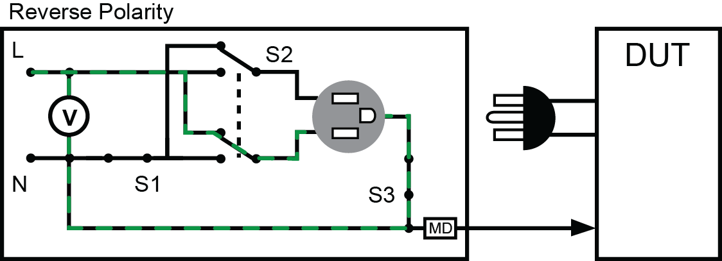

Slide 27
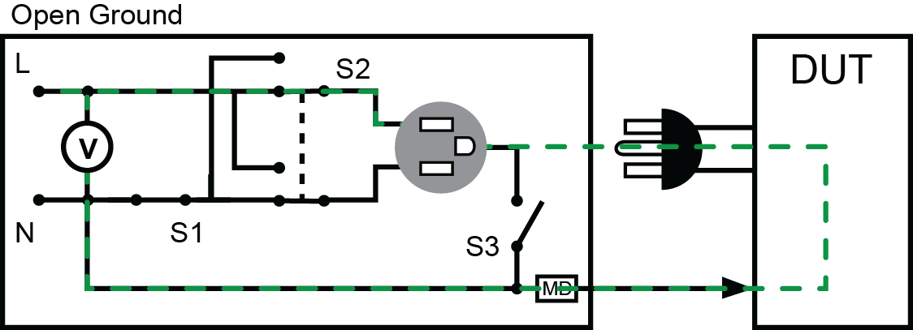

Slide 28
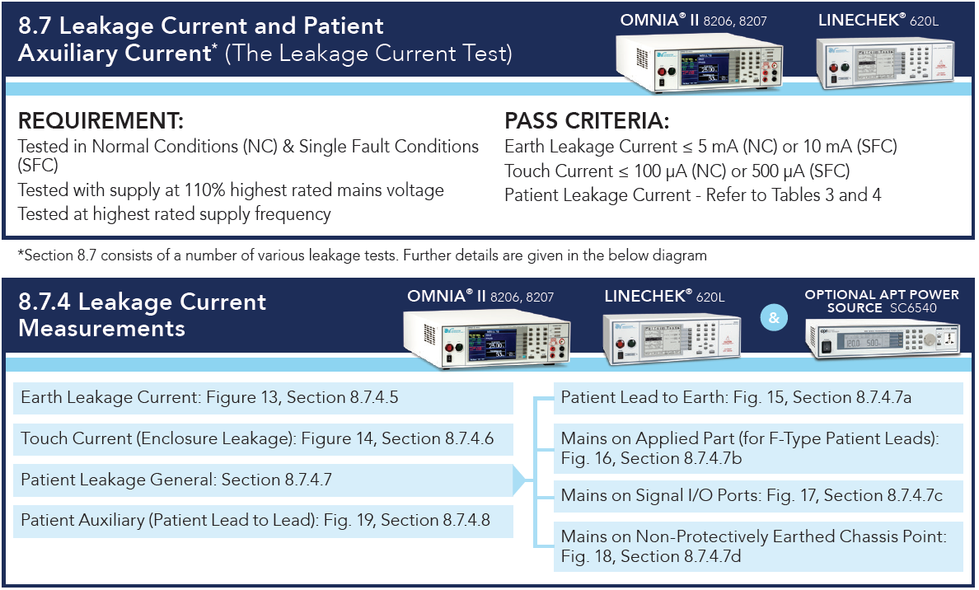
By the Standards – IEC 60601-1
Medical Equipment

Slide 29
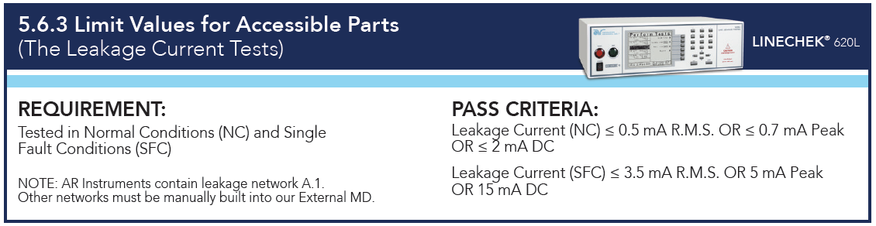
By the Standards – IEC 61010-1
Laboratory Equipment

Slide 30
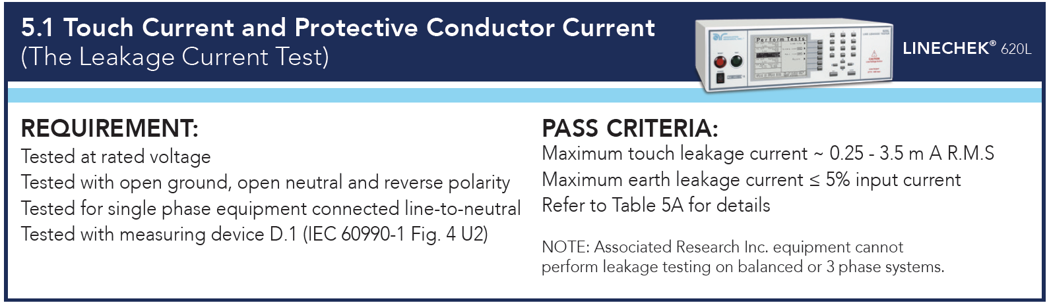
By the Standards – IEC 60950
IT Equipment

Slide 31
Poll Question 2

Slide 32
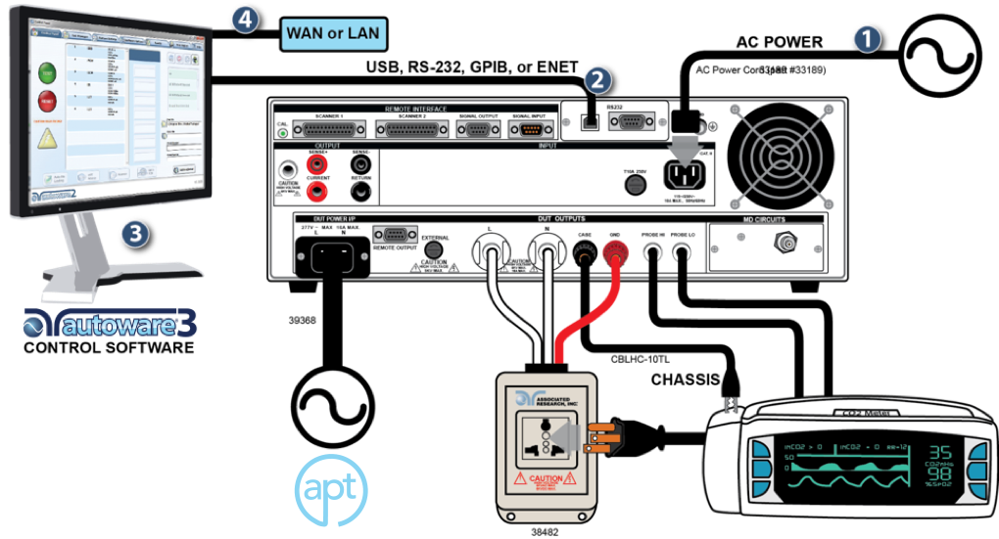

Slide 33

Contact Us
If you would like a copy of this presentation please email Brittany Socha at brittany.socha@arisafety.com
Check out our website for more information arisafety.com

Slide 34
JOIN US FOR OUR
NEXT WEBINAR
Wednesday, October 11 10AM CT (GMT – 6:00)
Leakage Current Testing -102
Click the link in chat box to learn more

